Slide 1
Icon Library

Slide 2











Wired Access Point

Slide 3



















ATM Router

Slide 4


Cloud

Slide 5


Generic Building

Slide 6











Laptop

Slide 7





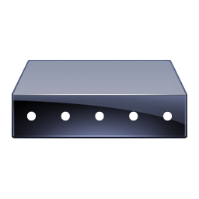




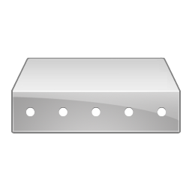
Modem

Slide 8
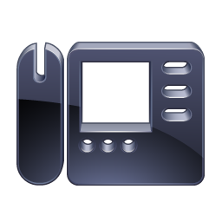
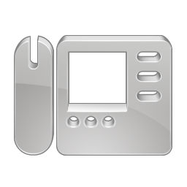
















Phone

Slide 9

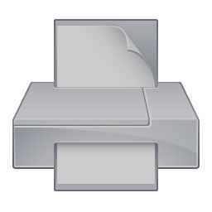
Printer

Slide 10


















Router

Slide 11
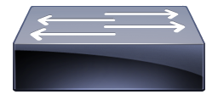
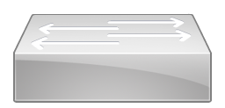
















Switch

Slide 12


Television

Slide 13











Wireless Bridge

Slide 14
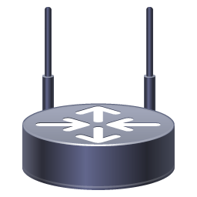
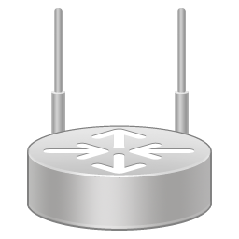
















Wireless Router

